Slide 1

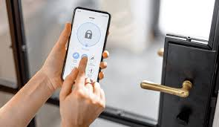
DOOR AUTOMATION USING ARDUINO

Slide 2
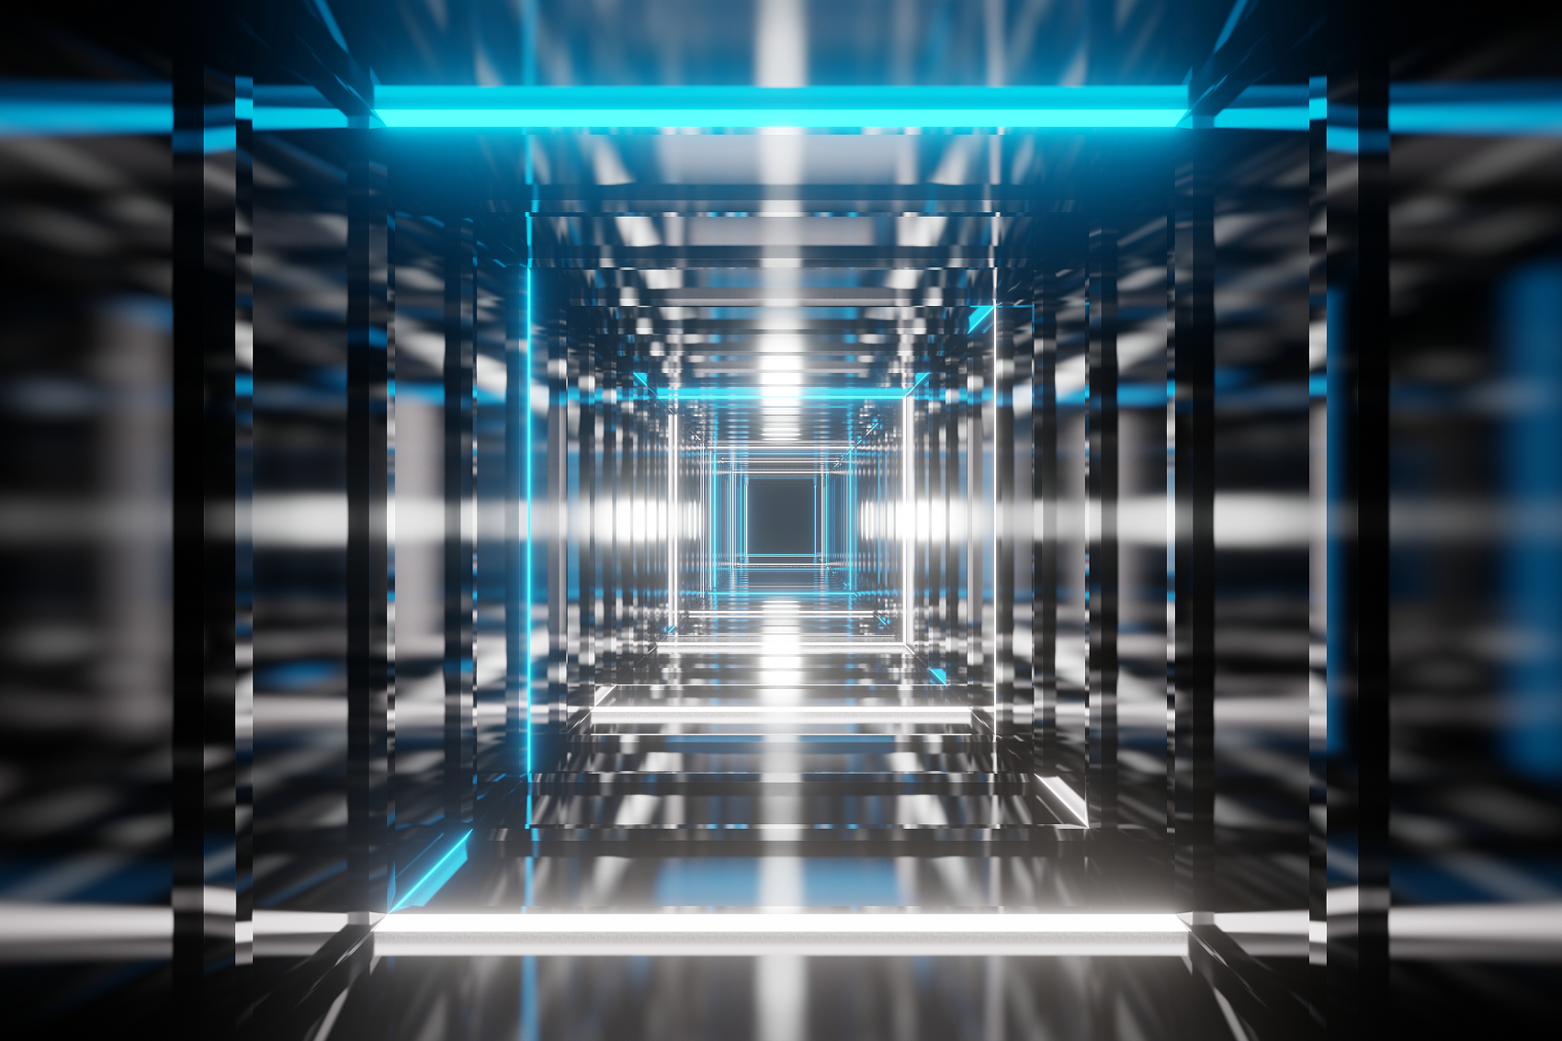
INDEX
01
02
03
INTRODUCTION
CIRCUIT DIAGRAM
COMPONENTS USED
04
05
06
APPLICATION
FUTURE SCOPE
REFERENCES

Slide 3
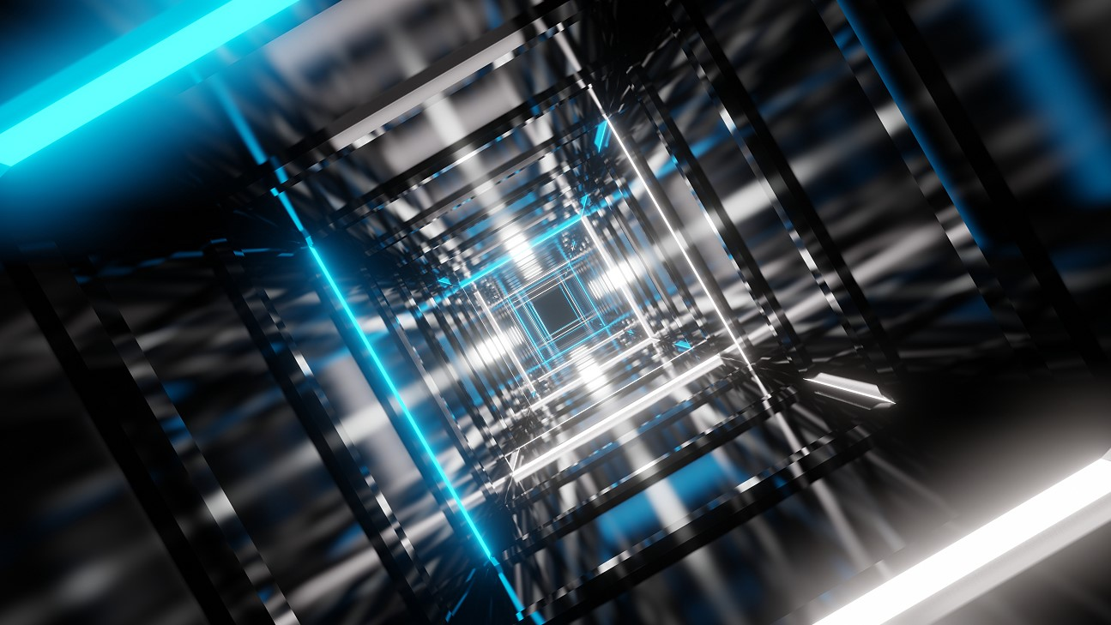
01
INTRODUCTION

Slide 4
Door Lock Automation is an innovative application of IoT (Internet of Things) technology, designed to enhance home security and convenience. This system utilizes smart sensors and electronic components to automate the process of locking and unlocking doors, providing users with remote control and monitoring capabilities.

Slide 5
02
CIRCUIT DIAGRAM

Slide 6
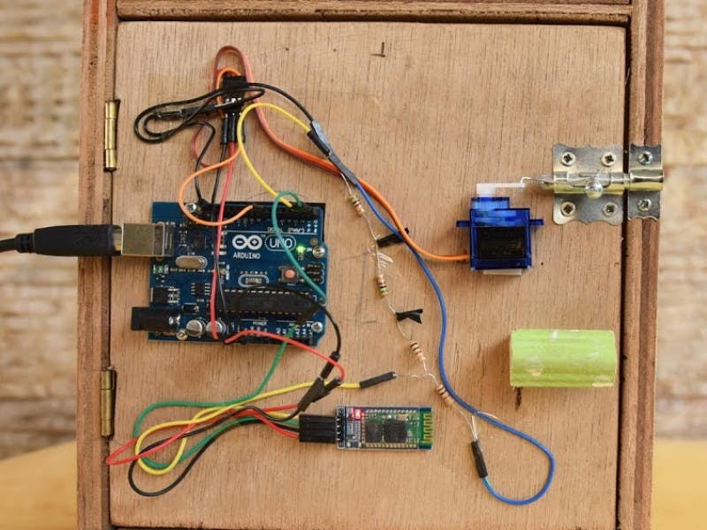
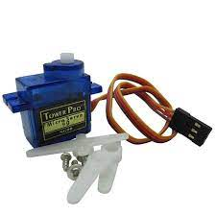
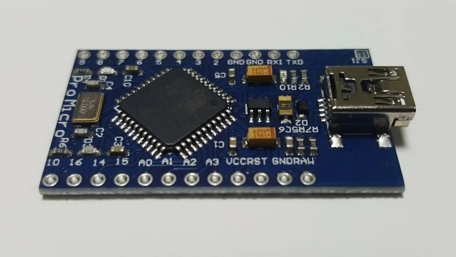
DOOR LOCK MECHANISM
The circuit consists of various elements such as microcontrollers, sensors (like RFID or biometric sensors), actuators (servo motors or solenoids), and connectivity modules (Wi-Fi or Bluetooth). The microcontroller processes input from sensors and triggers the actuators accordingly. The detailed circuit diagram illustrates the connections and interactions among these components.

Slide 7
03
COMPONENTS USED

Slide 8
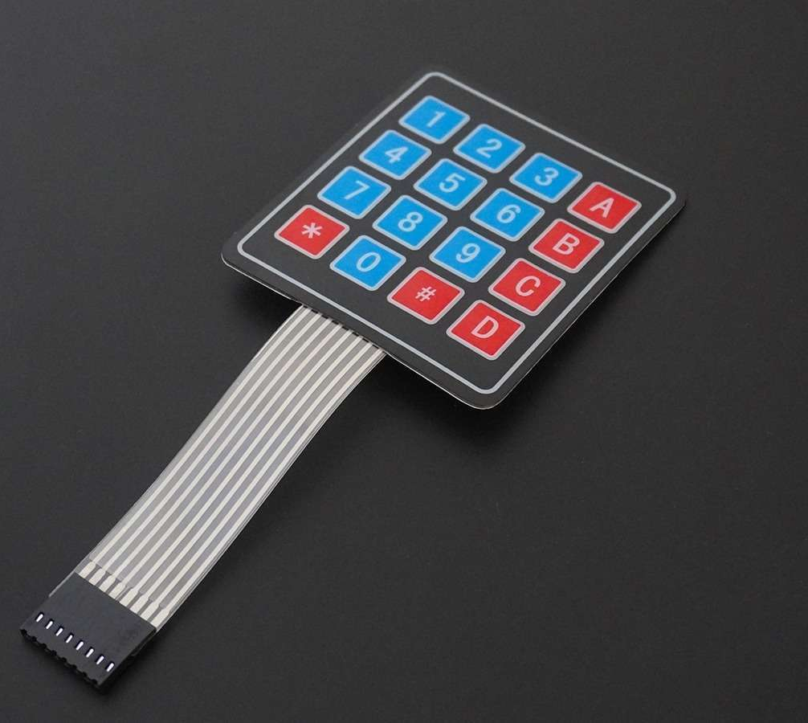
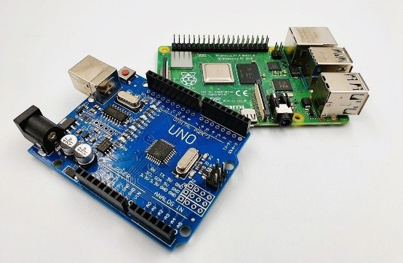
COMPONENTS USED
•Microcontroller
(e.g., Arduino or Raspberry Pi)
•KeyPad 4*4 Sensors
•Servo Motors/Solenoids
•Connectivity Modules
(Wi-Fi/Bluetooth)
Power Supply Unitinterface .

Slide 9
04
APPLICATIONS

Slide 10
Applications
Commercial Spaces
Home Security:
Suitable for offices, hotels, and other commercial establishments to manage access control efficiently.
Provides enhanced security features, allowing homeowners to monitor and control access remotely.
DOOR LOCK AUTOMATION
Rental Properties
Elderly Care
•Landlords can remotely manage access for tenants, enhancing property security.
Enables caregivers to monitor and control access to homes of elderly individuals, ensuring their safety.

Slide 11
04
FUTURE SCOPE

Slide 12
Future Scope
Integration with Smart Home Systems
Global Adoption:
Integration with existing smart home systems for seamless automation and enhanced user experience
Expanding the technology for global applications, addressing diverse security needs and cultural contexts
Machine Learning Algorithms:
Energy Efficiency:
Implementing machine learning algorithms for predictive analytics related to door usage and access patternsa
•Implementing energy-efficient components and algorithms to minimize power consumption.

Slide 13

Team Members:- Utkarsh Aggarwal Uday Kumar Utsav Jawla Sandeep Tiwari

Slide 14
03
THANK YOU

